Slide 1
Development and Enhancement of Text-to-Image Diffusion Model
Rajdeep Roshan Sahu
230215119
Supervisor: Mr. Ammar Yasir Naich
MS in ARTIFICIAL INTELLIGENCE
Queen Mary University of London

Slide 2
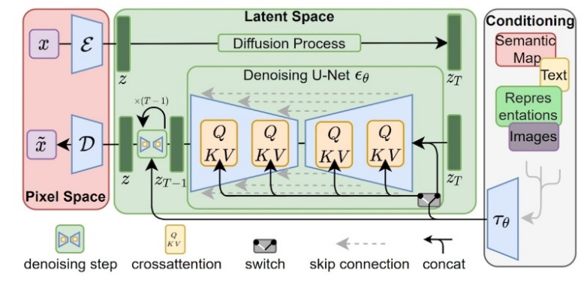
Introduction
Overview of Text-to-Image Diffusion Models
Motivation for taking this project
Key Challenges: Limited Sample Diversity, Training Instability
Objective: Enhance image quality, diversity, and stability
Fig.1. Architecture of a diffusion model
Queen Mary University of London

Slide 3
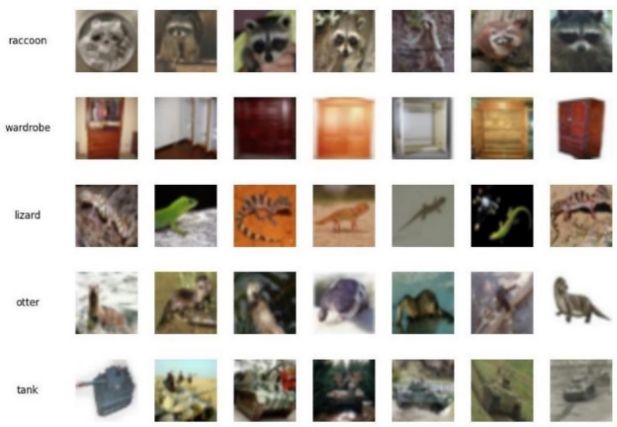
Methodology
Dataset: CIFAR-100
Model: stable-diffusion-v1.4 from hugging face
Key Techniques: Image Preprocessing, CFG Integration, EMA Stabilization
Use of Classifier-Free Guidance (CFG) and Exponential Moving Average (EMA)
Fig.2. CIFAR-100 dataset sample
Queen Mary University of London

Slide 4

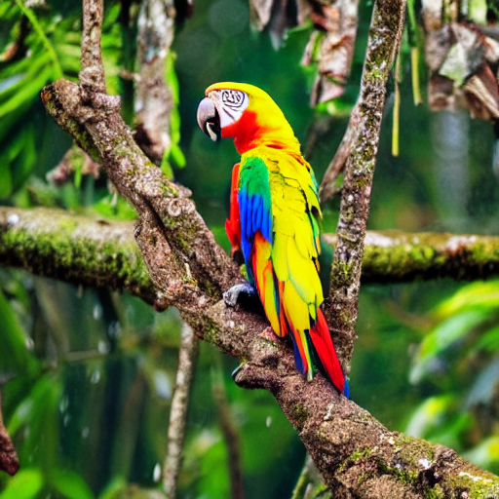

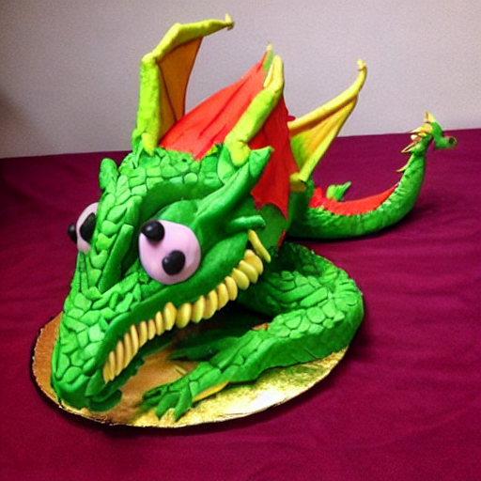



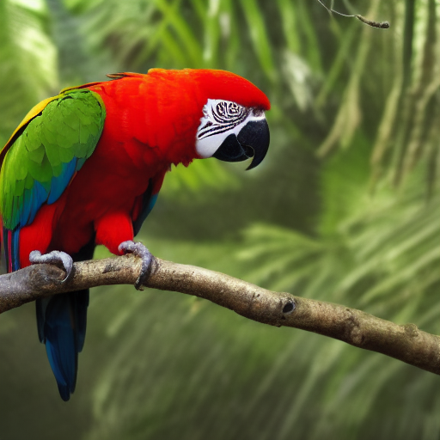
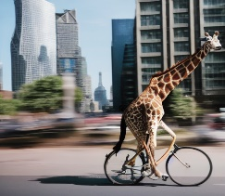



Outcomes
Qualitative Results:
Quantitative Results (FID Scores):
Baseline Model: 1332.33
Enhanced Model: 1088.94
 | A cat wearing a suit and glasses. | A colourful parrot in a rainforest. | A giraffe riding a bicycle through a city street. | A dragon made up of cake. | A sunset over an ocean, with a sailboat. | A futuristic cityscape in a cyberpunk style.
Base Model
Model with CFG & EMA
Fig.3. Outputs and their comparison from both the models
Queen Mary University of London

Slide 5
Comparative Analysis
Quantitative Analysis:
Significance of Lower FID Score
Implications for Image Quality and Realism
Qualitative Analysis:
Detailed Comparison of Image Quality
Diversity in Image Outputs
Adherence to Text Prompts
Practical Implications:
Impact of CFG and EMA on Model Stability
Real-World Applications and Use Cases
Queen Mary University of London

Slide 6
Conclusion
Achievements
Impact on Generative AI
Future Directions: Real-time Generation, Multi-Modal Integration, Exploring
different datasets for training, Cloud-based training and deployment and
Up sampling generated images for higher resolution
Queen Mary University of London

Slide 7
Thank You !
Contact
ec23715@qmul.ac.uk
rajdeeproshan2001@gmail.com
Queen Mary University of London

